Slide 1
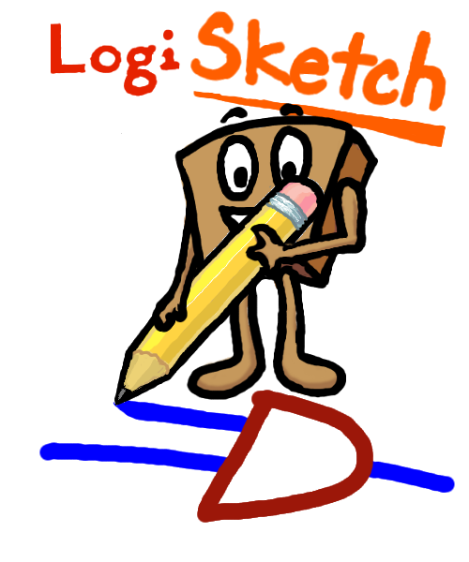

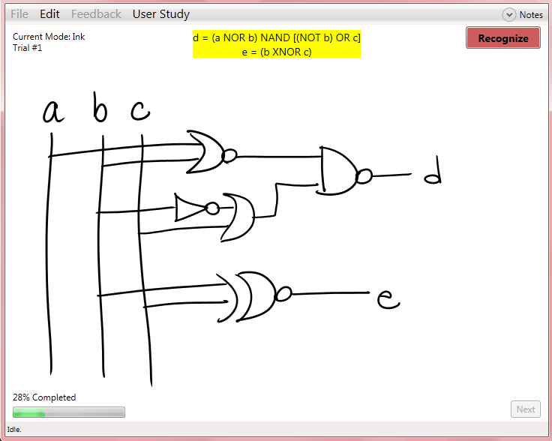
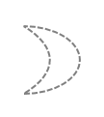
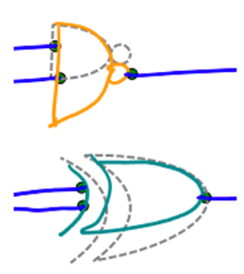

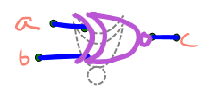


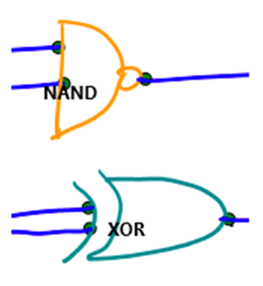
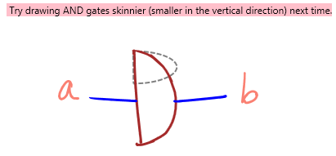

The Balance of Work between Users and Sketch-Recognition:
Encouraging Users to Adapt Their Drawing Styles
Kiley Sobel and Alexa Keizur
Introduction
Pen-based input presents many opportunities for new programs in which users can write and draw naturally. These types of programs often require the recognition of user input, creating more work at the back-end for systems. Therefore, new issues arise for those who develop pen-based programs.
User Study #1
Procedure
Condition 1: Only ghost gate feedback
Condition 2: Only text feedback
Hypothesis: Users in both conditions will adapt their drawing styles but users in Condition 1 will make more significant changes that will increase correct recognition rates compared to the users in Condition 2.
12 participants, 14 sketches each
Measure: How the users’ drawing styles changed over time (by sketch trial) by calculating the correct recognition rate (the percent of the total gates that were recognized correctly by the system) for each sketch.
Analysis & Results
Performing linear regression on the data provided no significant results overall. Thus, we concluded that neither feedback mechanism was powerful enough to influence users to change their drawing styles.
User survey data indicated that in general users did not understand what the ghost gates were trying to tell them in terms of how to change their drawing styles. Therefore, we decided to investigate if being more explicit with drawing advice in addition to the ghost gates would lead to a better understanding of the desired changes. This lead to User Study #2.
User Study #2
Procedure
Condition 1: Ghost gate feedback and drawing advice feedback
Condition 2: Only text feedback
Hypotheses:
Users in both cases will adapt their drawing styles but users in Condition 1 will make more significant changes that will increase correct recognition rates compared to the users in Condition 2.
Users in Condition 1 will make more significant adjustments to their gates’ ratios of width to height toward the preferred ratio compared to users in Condition 2.
22 participants, 14 sketches each
Measures:
How the users’ drawing styles changed over time (by sketch trial) by calculating the correct recognition rate (the percent of the total gates that were recognized correctly by the system) for each sketch.
How the users’ drawing styles changed over time by calculating the ratio of width to height of each gate by type in the order they were drawn.
In our research we wanted to answer the following question that addresses these types of issues: Can certain feedback mechanisms encourage users to adapt their drawing styles to what the system needs to recognize user input accurately?
We carried out this research using LogiSketch, a pen-based tablet PC program that enables users to sketch and simulate circuit diagrams. If this program could successfully influence users to change how they draw, the program would not have to work as hard to recognize all types of drawing styles. The implications of successfully encouraging users to change their natural drawing style could be extremely influential for all types of pen-based recognition programs.
Feedback Mechanisms
LogiSketch provides three types of feedback to users after it recognizes their drawings: ghost gate feedback, text feedback, and drawing advice. Feedback disappears when the user puts his or her pen down and reappears when the user hovers over gates.
Analysis & Results
Ghost Gate Feedback
Ghost gates appear after sketch recognition. These outlines are in the preferred ratio of width to height but always match the widths of the users’ hand-drawn shapes. Users are able to rotate these outlines.
Example of how a user changed her OR, XNOR, and NAND gates over time.
Text Feedback
The system displays text feedback as the name of each of the recognized gates on the sketch.
Again, performing a linear regression on the recognition data did not give us significant results. In addition, there were no significant trends in the change in ratio of width to height of gates for users in either condition. However, users did experiment with changing the ratios of the dimensions of their gates. This provides evidence that users were trying to figure out how to best draw their gates to match what they believed the system wanted. Thus, with the right type of feedback, it may be possible to effectively guide users’ changes in the way the system wants.
Drawing Advice Feedback
Drawing advice appears after a user relabels a shape when it is recognized incorrectly originally and indicates to the user how to draw the gate in the future to better match the preferred ratio of width to height. If applicable to the gate, it may tell the user to draw the back of the gate curvier in the future.
Acknowledgements:
We’d like to thank our research advisor, Professor Christine Alvarado, all the students who have worked on this project in the past, and the students who participated in the user studies.
This work is supported in part by an NSF CAREER award (IIS-0546809).
Future Work
Develop new feedback mechanisms.
Investigate the user study under different conditions with new feedback mechanisms.
Run additional studies using an Adaptive Image Recognizer.

